Slide 1
Unit V- Software Testing
Objectives:
  Development Testing
  Test Driven Development
  Release Testing
  User Testing

Slide 2
Types of Testing
There are many types of software testing :
  Visual testing
  Specification based testing
  Software development testing
  Functional & Non-functional testing
  Performance Testing
  Alpha Testing
  Beta Testing

Slide 3
Black box testing and white box testing are two fundamental software testing approaches used to evaluate software applications, each with a distinct focus and methodology.
1. Black Box Testing:
Definition: Black box testing is a software testing method where the tester evaluates the functionality of the software without having any knowledge of its internal structure, code, or implementation.
Focus: This approach focuses on what the software does (i.e., its outputs or behavior) rather than how it is implemented.
Test Cases: Test cases are derived based on software requirements, specifications, or user stories.
Common Techniques:
  Equivalence Partitioning: Dividing inputs into groups that are expected to behave similarly.
  Boundary Value Analysis: Testing at the boundaries between different input groups.
  Decision Table Testing: Testing different combinations of inputs.
  State Transition Testing: Testing different states of the software based on inputs/events.
Advantages:
  Does not require knowledge of the code, making it suitable for non-developers or external testers.
  Focuses on user experience and functional correctness.
Disadvantages:
  Cannot test the internal workings or code-level issues.
  Coverage may be limited to functional aspects.
Example: Testing a login form by entering valid and invalid username/password combinations without knowing how the system processes them internally.

Slide 4
2. White Box Testing:
Definition: White box testing (also known as clear box or glass box testing) is a method where the tester has full visibility into the internal workings, code structure, and implementation of the software.
Focus: This approach focuses on how the software works (i.e., the code, logic, and internal paths). Test Cases: Test cases are written based on the code, control flows, and data flows.
Common Techniques:
  Statement Coverage: Ensuring every statement in code executed at least once.
  Branch Coverage: Testing every possible branch (decision point) in the code.
  Path Coverage: Ensuring all possible paths through the code are tested.
  Loop Testing: Testing loops to ensure proper execution under different conditions.
Advantages:
  Provides thorough testing of the codebase.
  Helps in identifying hidden errors like security vulnerabilities, logical errors, and edge cases.
Disadvantages:
  Requires in-depth knowledge of the code and development expertise.
  Time-consuming for large or complex applications.
Example: Testing each function of a software module by analyzing the code and covering all possible branches and paths.

Slide 5
Why Testing…..?
  Testing is intended to show that a program does what it is intended to do and to discover program defects before it is put into use.
  The testing process has two distinct goals:
    To demonstrate to the developer and the customer that the software meets its requirements.
    To discover situations in which the behavior of the software is incorrect, undesirable, or does not conform to its specification.
  The first goal leads to validation testing, where you expect the system to perform correctly using a given set of test cases.
  The second goal leads to defect testing, where the test cases are designed to expose defects.

Slide 6
Why Testing…..?
Testing demonstrates that the software is free of defects or that it will behave as specified in every circumstance.
The ultimate goal of verification and validation processes is to establish confidence that the software system is ‘fit for purpose’.
Testing is part of a broader process of software verification and validation (V&V).
It is concerned with checking the software being developed meets its specification and delivers the functionality expected by the people paying for the software.

Slide 7
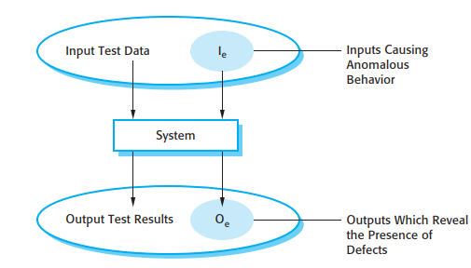
Why Testing…..?
Barry Boehm, a pioneer of software engineering, succinctly expressed the difference during 1979 -
  Validation: Are we building the right product?
  Verification: Are we building the product right?

Slide 8
Typical examples of Software functionalities to test :
Business Rules
Transaction corrections, adjustments and cancellations
Administrative functions
Authentication
Authorization levels
Audit Tracking
External Interfaces
Certification Requirements
Reporting Requirements
Historical Data
Legal or Regulatory Requirements

Slide 9
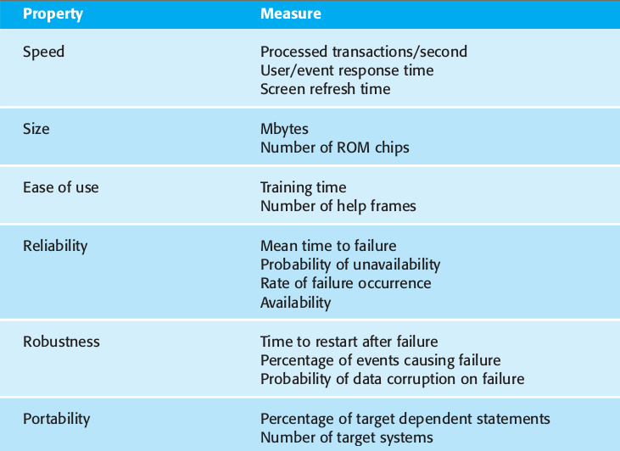
Non-functional aspects for Testing

Slide 10
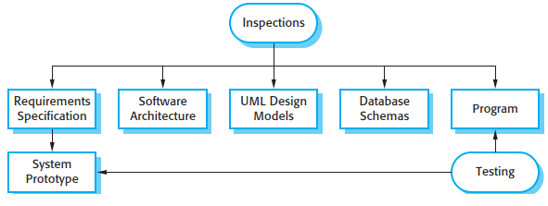
Inspection & Testing
The verification and validation process involve software inspections and reviews.
Inspections and reviews analyze and check the system requirements, design models, the program source code, and even proposed system tests. These are so-called ‘static’ V & V techniques.
software inspections and testing support V & V at different stages in the software process.

Slide 11
Inspection V/s Testing
There are three advantages of software inspection over testing
  Inspection is a static process, you don’t have to be concerned with interactions between errors.
  Incomplete versions of a system can be inspected against specifications without additional testing costs.
  An inspection can also consider broader quality attributes of a program like standards compliance, portability & maintainability.
Inspections are not good for discovering defects that arise during interactions of different parts/objects of a program, timing problems and the system performance.

Slide 12
Traditional Testing Process…
In plan driven development, an abstract model of the ‘traditional’ testing process is used.
In this process, test cases are created with test data or inputs to test the system, the expected output and the actual output are compared and conclusions are driven from the test.
In automated system tests, using the test case with expected results execution can be automated. The expected results are automatically compared with the predicted results to look for errors and anomalies in the test run.

Slide 13
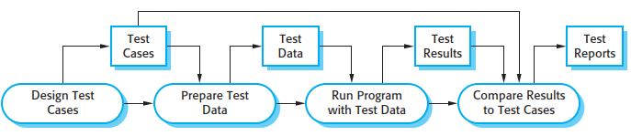
Traditional Testing Process…

Slide 14
Commercial Software 3 stages of Testing
Development Testing: where the system is tested during development to discover bugs and defects. System designers, programers and associated testers are likely to be involved in the testing process. They are responsible for developing tests and maintaining detailed records of test results
Release testing: where a separate testing team tests a complete version of the system before it is released to users. The aim of release testing is to check the system meets the requirements of system stakeholders.

Slide 15
Commercial Software Testing
User Testing : where users or potential users of a system test the system in heir own environment. For software products, the ‘user’ may be an internal marketing group who decide if the software can be marketed, released, and sold.
Acceptance Testing: is one type of user testing where the customer formally tests a system to decide if it should be accepted from the system supplier or if further development is required.

Slide 16
Development Testing
During development, the testing may be carried out at 3 levels of granularity:
Unit testing, where individual program units or object classes are tested. Unit testing should focus on testing the functionality of objects or methods.
Component testing, where several individual units are integrated to create composite components. Component testing should focus on testing component interfaces.

Slide 17
Development Testing
System testing, where some or all of the components in a system are integrated and the system is tested as a whole. System testing should focus on testing component interactions.
As an overview of Development testing, we can see that it is primarily a defect testing mechanism. During process the main aim of testing is to discover bugs in the software.

Slide 18
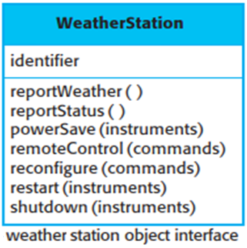
Development Testing : Unit testing
Unit testing is the process of testing program components, such as methods or object classes. Individual functions or methods are the simplest type of components.
While testing object classes, you should design your tests to provide coverage of all of the features of the object. That is test all operations associated, set and check the value of all attributes associated, put the object into all of its possible states.
Example Weather station object interface:
  The interface of this object is identifier
  Define test cases for all methods defined
  viz, reportweather(), reportstatus(), restart()
Unit testing mostly automation preferred
to reset & restart all methods at once.

Slide 19
State Diagrams are a powerful tool in software engineering for capturing and visualizing the dynamic behavior of event-driven systems or have complex state-dependent behaviors.
Vital tool used to represent the different states of an object or system and how it transitions between those states based on various events, especially those that respond to external events or inputs.
These are helpful in Visualizing System Behavior, Clarifying Requirements, Defining Object Lifecycle, Modeling Real-time and Embedded Systems, Testing and Validation.
State Diagrams consists of start / stop, states, transitions, events & triggers, actions.

Slide 20
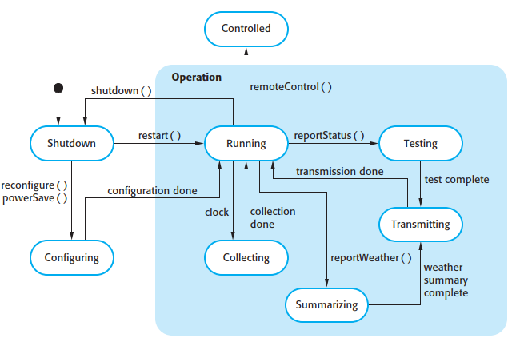
Development Testing
Example: Weather Station State Diagram for Ref.

Slide 21
Choosing Unit Test Cases
Testing is expensive and time consuming, so it is important that you choose effective unit test cases based on following points:
The test cases should show that, when used as expected, the component that you are testing does what it is supposed to do.
If there are defects in the component, these should be revealed by test cases.
Classify/ group the test cases with partitions, based on the upper limit and lower limit specified in the software.

Slide 22
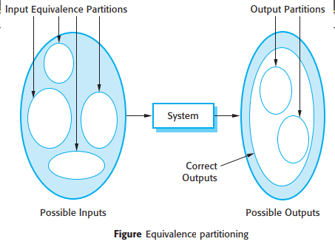

Slide 23
Choosing Unit Test Cases
There should be two kinds of test cases.
  The first of these should reflect normal operation of a program and should show that the component works.
  The second, kind of test case should be based on testing experience of where common problems arise and check abnormal inputs processed properly and component doesn't crash.
Equivalence class partitioning technique achieves aforesaid points. Boundaries refers classes.
Guideline-based testing, where guidelines reflect the previous experience observed on programmers commit errors while developing components.

Slide 24
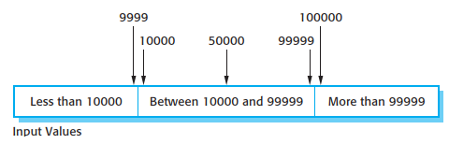
Guidelines that could help and reveal defects include:
Test software with sequences that have only a single value. Programmers naturally think of sequences as made up of several values and sometimes they embed this assumption in their programs. Consequently, if presented with a single value sequence, a program may not work properly.
Use different sequences of different sizes in different tests. This decreases the chances that a program with defects will accidentally produce a correct output because of some accidental characteristics of the input.
Derive tests so that the first, middle, and last elements of the sequence are accessed. This approach reveals problems at partition boundaries.

Slide 25
Development Testing- Component Testing
Assume software has modules/ components A, B, C,D, which have been integrated to create a larger component or subsystem.
There are different types of interface between program components. Consequently, we can expect different types of interface error that can occur:
  Parameter interfaces
  Shared memory interfaces
  Procedural interfaces
  Message passing interfaces

Slide 26
Component Testing: Interface Errors
Interface errors are one of the most common forms of error in complex systems. These errors fall into three classes:
  Interface misuse
  Interface misunderstanding
  Timing errors
General guidelines for interface testing wih 5 key points to remeber :
  Examine the code to be tested and explicitly list each call to an external component.
  Where pointers passed across interface, test it with null pointer parameters.

Slide 27
Component Testing: Interface Errors
  Where a component is called through a procedural interface, design tests that deliberately cause the component to fail.
  Use stress testing in message passing systems, which produces messages more than the real time so as to see timing problem.
  Where several components interact through shared memory, design tests that vary the order in which these components are activated.
  As mentioned earlier, the inspections and their reviews will workout cost effective compared to the above as they concentrate on interface behavior.

Slide 28
System Testing
System testing during development involves integrating components to create a version of the system and then testing the integrated system.
Eventhough it overlaps with component testing there are two main differences :
    Re-useable components and off-the-shelf systems may also be integrated with new components.
    Components developed by different team members or groups may be integrated at this stage. System testing is a collective rather than an individual process.

Slide 29
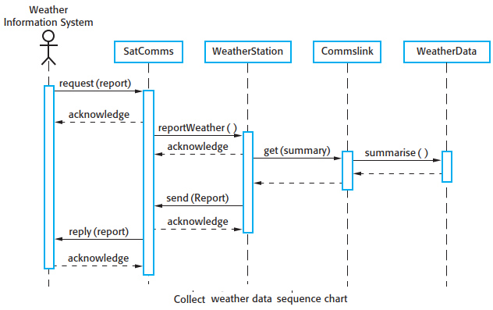
This means, some elements of system functionality only become obvious while putting the components together.
Because of its focus on interactions, use case–based testing is an effective approach to system testing.

Slide 30
Therefore, issuing a request for a report will result in the execution of the following thread of methods:
  SatComms:request →WeatherStation:reportWeather →Commslink:Get(summary) →WeatherData:summarize
The sequence diagram helps you design the specific test cases that you need as it shows what inputs are required and what outputs are created:
  An input of a request for a report should have an associated acknowledgment. A report should ultimately be returned from the request.
  An input request for a report to WeatherStation results in a summarized report being generated.

Slide 31
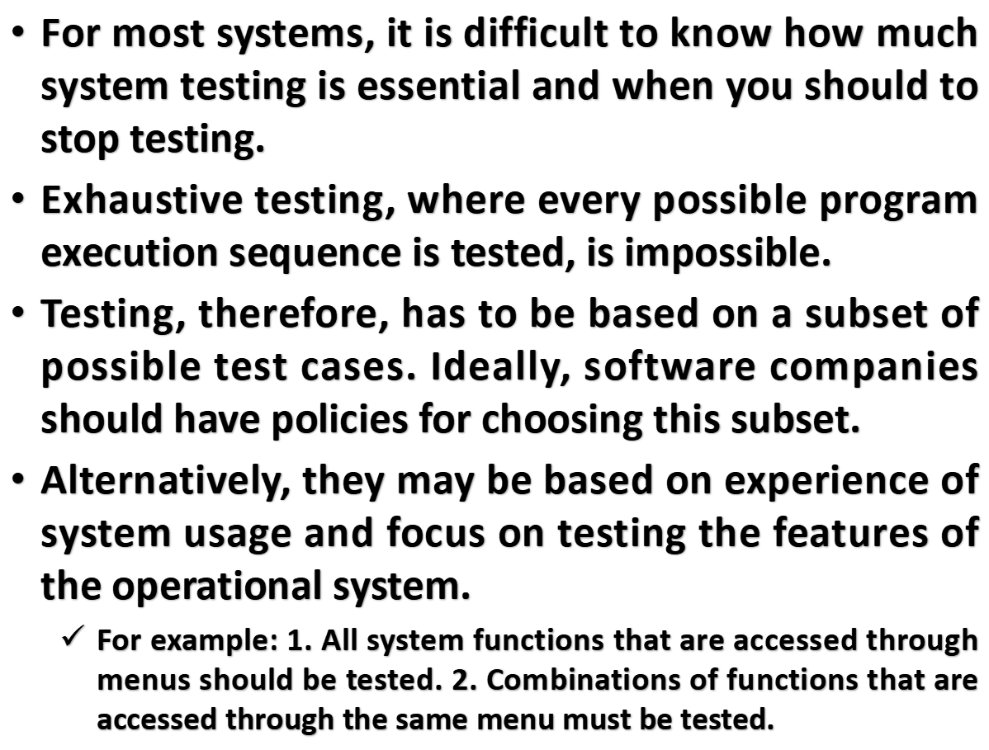

Slide 32
Test-driven development- TDD
Test-driven development (TDD) is an approach to program development in which you interleave testing and code development.
Essentially, It is incremental development model. The code developed along with a test for that increment. You don’t move on to the next increment until the code that you have developed passes its test.
Test-driven development was introduced as part of agile methods such as Extreme Programming.

Slide 33
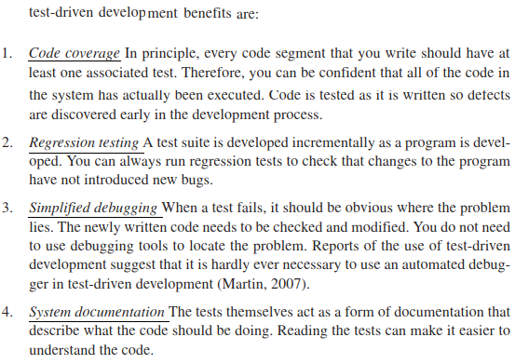

Slide 34
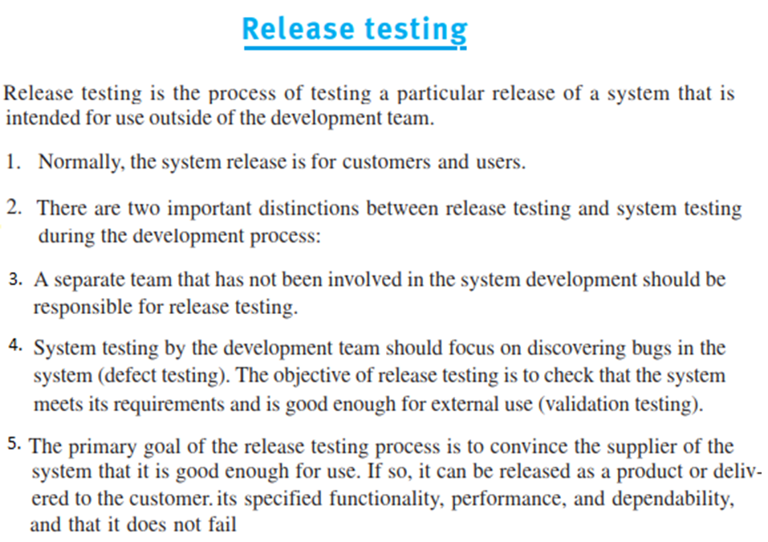

Slide 35
